Slide 1
CSCE 5200 Information Retrieval and Web Search
Chapter 1: Boolean retrieval

Slide 2
Introduction (1 of 4)
Definition
Information retrieval (IR) is finding material (usually documents) of an unstructured nature (usually text) that satisfies an information need from within large collections (usually stored on computers).
Also covers supporting users in browsing or filtering document collections or further processing a set of retrieved documents.
Docuemnt Clustering
Text Classification

Slide 3
Introduction ( 2 of 4)
IR systems usually adopt index terms to index and retrieve documents
Index term:
a keyword or group of related words, which has some meaning of its own
Usually has the semantics of a noun
Any word appearing in the text of a document (its more general form)
Stemming might be used:
connect: connecting, connection, connections
An inverted file is built for the chosen index terms

Slide 4
Introduction (3 of 4)
One central problem: predicting which documents are relevenat, and which are not
Dependent on a ranking alogrithm
A ranking is an ordering of the documents retrieved that (hopefully) reflects the relevance of the documents to the user query
A ranking is based on fundamental definitions regarding the notion of relevance, such as:
common sets of index terms
sharing of weighted terms
likelihood of relevance
Each definition of relevance leads to a distinct IR model

Slide 5
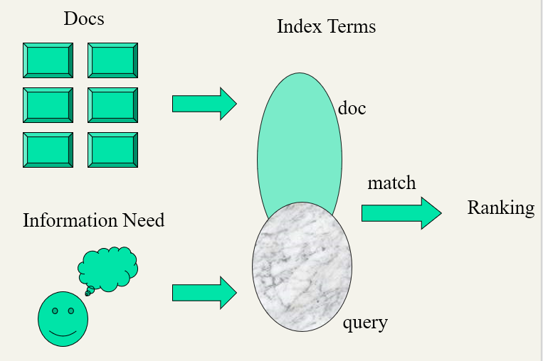
Introduction (4 of 4)
The document collection and queries (information needs) are represented by index terms, and then participating in searching, matching, and ranking process.

Slide 6
Outline of Chapter 1
A simple example of an information retrieval problem
The idea of a term-document matrix (Section 1.1)
The central inverted index data structure (Section 1.2).
Boolean retrieval model (Section 1.3)
How Boolean queries are processed (Section 1.4).

Slide 7
An example information retrieval problem
Which plays of Shakespeare contain the words Brutus AND Caesar but NOT Calpurnia?
One way: start at the beginning and read through all the text, noting for each play whether it contains Brutus and Caesar and excluding it from consideration if it contains Calpurnia.
This sort of linear scan through documents: slow (for large corpora)
Goal:
To process large document collections quickly
To allow more flexible matching operations
find the documents where Romans near countrymen and near might be defined as “within 5 words” or “within the same sentence”
To allow ranked retrieval
best answer to an information need among many documents that contain certain words

Slide 8
An example information retrieval problem, cont.
The way to avoid linearly scanning the texts for each query: index the documents in advance.
Suppose we record for each document–here a play of Shakespeare’s - whether it contains each word out of all the words Shakespeare used.
What is the result?

Slide 9
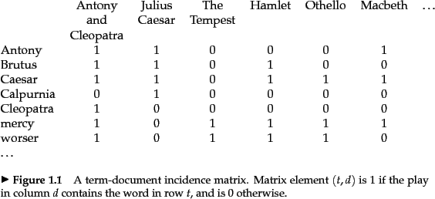
A term-document incidence matrix
Fig. 1.1. A term-document incidence matrix. From “ Introduction to Information Retrieval”(C. Manning, P. Raghavan and H. Schütze,, 2008, pg.4).
Matrix element (t, d) is 1 if the play in column d contains the word in row t, and is 0 otherwise
Brutus AND Caesar but NOT Calpurnia

Slide 10
Incidence vectors
So we have a 0/1 vector for each term.
To answer query: Brutus AND Caesar but NOT Calpurnia
Take the vectors for Brutus, Caesar and Calpurnia (complement the last) ➔ bitwise AND.
110100 AND 110111 AND 101111 = 100100.

Slide 11
Answers to query
Antony and Cleopatra, Act III, Scene ii
Agrippa [Aside to DOMITIUS ENOBARBUS]: Why, Enobarbus,
When Antony found Julius Caesar dead,
He cried almost to roaring; and he wept
When at Philippi he found Brutus slain.
Hamlet, Act III, Scene ii
Lord Polonius: I did enact Julius Caesar I was killed i' the
Capitol; Brutus killed me.
Results from Shakespeare for the query Brutus AND Caesar but NOT Calpurnia

Slide 12
Boolean Retrieval Model
A model for information retrieval in which we can pose any query in the form of a Boolean expression of terms
Terms are combined with the operators AND, OR, and NOT.
The model views each document as just a set of words

Slide 13
Bigger collections
Consider N = 1 million documents, with each document about 1000 words long (2–3 book pages).
If we assume an average of 6 bytes per word including spaces and punctuation
This is a document collection about 6 gigabytes (GB) in size.
Typically, there might be about M = 500,000 distinct terms in these documents.

Slide 14
Can’t build the matrix
A 500K x 1M matrix has half-a-trillion 0’s and 1’s.
Too many to fit in a computer’s memory
N = 1 million documents, with each document about 1000 words long, about M = 500,000 distinct terms in these documents
One crucial observation
Matrix is extremely sparse.
It has few nonzero entries.
Q: how many non-zero entries in the matrix?
A minimum of 99.8% of the cells are zero.
What’s a better representation?
Record only the things that do occur
i.e., the 1 positions

Slide 15
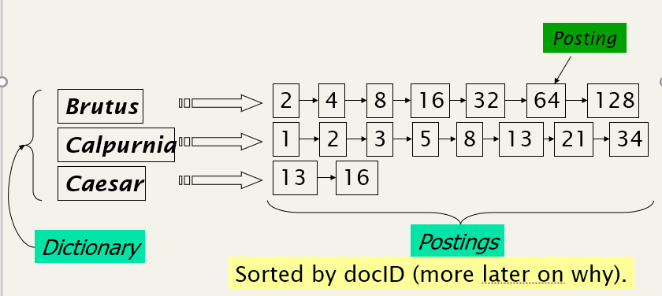
Inverted index
The two parts of an inverted index.
Each item in the list – records that a term appeared in a document: conventionally called a posting.
The list: called a postings list (or inverted list)
All the postings lists taken together: referred
to as the postings.

Slide 16
Inverted index, cont.
Inverted index construction
To gain the speed benefits of indexing at retrieval time
have to build the index in advance.

Slide 17
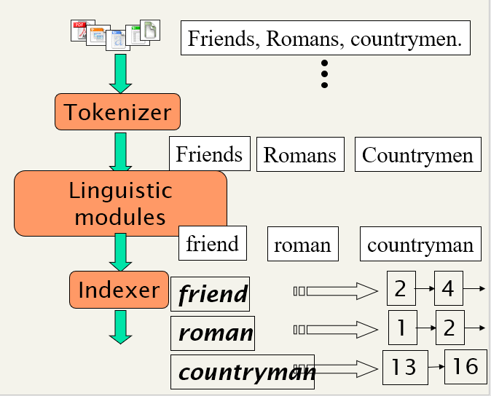
Inverted index construction
Collect Documents to
be indexed.
Tokenize the text, turning each document into a list of tokens
Token stream.
Normalized tokens:
indexed terms
Inverted index: consisting of
a dictionary and postings.

Slide 18
Indexer steps: sort-based indexing(1 of 3)
Assume that each document has a unique document identifier(docID).
During index construction, simply assign successive integers to each new document when it is first encountered.
Input to indexing: a list of normalized tokens for each document
a list of pairs of term and docID
Doc 1
Doc 2
I did enact Julius
Caesar I was killed
i' the Capitol;
Brutus killed me.
So let it be with
Caesar. The noble
Brutus hath told you
Caesar was ambitious

Slide 19
Indexer steps: sort-based indexing(2 of 3)
Sorting this list
terms are alphabetical.
Core indexing step.

Slide 20
Indexer steps: sort-based indexing(3 of 3)
Multiple occurrences of the same term from the same document are then merged.
Frequency information is added.
Why frequency?
Will discuss later.

Slide 21
Dictionary file and Postings
Fig. 1.4. Building index by sorting, grouping, and then splitting into Dictionary file and postins. From “ Introduction to Information Retrieval”(C. Manning, P. Raghavan and H. Schütze,, 2008, pg.8).

Slide 22
Indexer steps: sort-based indexing, cont.
The dictionary stores the terms, and has a pointer to the postings list for each term.
The dictionary records some statistics
E.g. the number of documents which contain each term (the document frequency, which is also the length of each postings list).
Improve query time efficiency and, later, for weighting in ranked retrieval models.
Each postings list stores the list of documents in which a term occurs
Store other information such as the term frequency (the frequency of each term in each document) or the position(s) of the term in each document.

Slide 23
Exercise
Exercise 1.1. from “ Introduction to Information Retrieval”(C. Manning, P. Raghavan and H. Schütze,, 2008, pg. 9).

